Slide 1
Vitamins
Name
Institution
Date

Slide 2
Introduction
Vitamins are essential blocks that your body needs to grow.
There are 13 vitamins that the body needs.
Vitamins play a paramount role in the body, such as resisting infections.
This presentation sheds light on vitamin A and vitamin D
Notes:
The human body is never complete without vitamins, which your body needs to grow and develop normally. As evident, there are about 13 vitamins that the body needs to function normally, and these include Vitamin A, Vitamin B, Vitamin C, and Vitamins D, among other essential vitamins.
Vitamins help the body resist infections, keep your nerves healthy, and help your body get energy from foods or our blood to clot properly. This presentation sheds light on vitamin a and vitamin D

Slide 3
The Solubility of Vitamin A and Vitamin D
Vitamin A
Vitamin A esters are highly soluble on fats, oils, and acetone.
Vitamin A esters are made of a group of soluble compounds in alcohol but insoluble in water.
The main dietary form of vitamin A is retinol.
Vitamins D
Vitamin D is highly soluble in fat and oil.
It dissolves in fats and oils and can be stored in your body for a long time.
Notes:
Vitamins are grouped as either fat-soluble or water-soluble. In our context, vitamin A comprises esters, which are highly soluble in fat and oil but insoluble.
Similarly, Vitamin D is a fat-soluble vitamin. All these vitamins are highly soluble in lipids.

Slide 4
The Function of the Vitamins in the Body
Vitamin A
Vitamin A are varied aspects of a body function, and these include:
  Immune function
  Body with
  Hair growth
  Vision maintenance
  Reproductive function
Vitamin D
Vitamin D helps the body in:
  Immune system regulation
  Bone maintenance
Notes:
All vitamins occupy a dominant position in the human body and hence, vitamins A and D are not exceptional. Notably, vitamin A helps in vision maintenance by maintaining light-sensing cells in the eye and accurate tear fluid development. Vitamin A boosts the immune system through increasing susceptibility to infections. It enhances cell growth and hair growth. The vitamin also maintains fertility and aids in fetal development.
On the other hand, Vitamin D functions through regulating the circulation of calcium and phosphorus, core elements of bone maintenance. It also maintains and strengthens immune system functions.

Slide 5
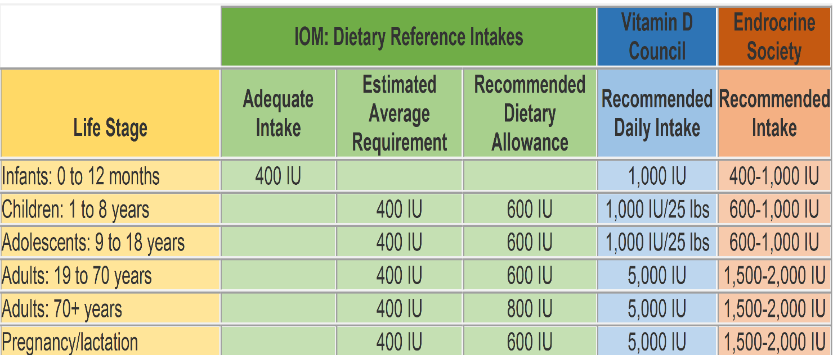
Daily Reference Intakes (DRI) Recommended For Vitamin A and Vitamin D
Vitamin D
Vitamin A
GENDER | AGE | RDA (IU / mcg) | UL (IU / mcg)
Women | 14–18 years | 2,333 / 700 | 9,333 / 2800
 | 19–70 years | 2,333 / 700 | 10,000 / 3000
Men | 14–18 years | 3,000 / 900 | 9,333 / 2800
 | 19–70 years | 3,000 / 900 | 10,000 / 3000
Notes:
The DRIs are values used to plan and examine nutrient intakes of healthy people. The affiliated standards tend to differ per age. The DRI for Vitamins A and D are as shown in the above tables.

Slide 6
Food Sources to Eat to Obtain the Vitamins
Vitamin A are highly available in foods such:
  Carrots
  Spinach
  Sweet potatoes
  Lettuce
  Red bell peppers
  Tuna
The healthiest sources of vitamin D consist of:
Canned tuna
Egg yolks
Cod liver oil
Fatty fish
Notes:
Vitamin D is commonly provided by foods such as salmon, a popular fatty fish. Cod liver oil is another significant source of vitamin D (Gil, Plaza-Diaz, & Mesa, 2018).
The majority of people enjoyed taking canned tuna as significant vitamin D sources, which contains about 268 IU of vitamin D per serving. Egg yolks provide about 37 IU of Vitamin D per yolk.
On the other hand, the concentration of preformed vitamin A is high in carrots, which produces 148% DV, tuna 143% DV, Sweet potatoes 122% DV, and spinach 105% DV, among other vitamins A-rich food.

Slide 7
Toxicity Signs And Symptoms
Vitamin A
The major signs of hypervitaminosis A include:
  Irritability (hernandez & hardy, 2020)
  Drowsiness
  Abdominal pain
  Nausea
  Vomiting and increased pressure on the brain
  Blurry visions
Vitamin D
Hypervitaminosis D is a rare but challenging health issue (bilbao, 2017).
The major signs of vitamin d toxicity include:
  Fatigue
  Loss of appetite
  Excessive urination
  Kidney damage
  Calcification
Notes:
Too much vitamin A in the body can be toxic. It leads to increased signs of irritability (a feeling of agitation) (Hernandez & Hardy, 2020). Other detrimental symptoms include but are not limited to abdominal pain, nausea, vomiting, and increased pressure on the brain. Some signs of chronic vitamin A toxicity include swelling of the bones, blurry vision, and poor appetite.
On the other hand, too much vitamin D in the body leads to increased incidences of fatigue, loss of appetite, dehydration, constipation, and excessive urination. The affiliated long-term complications of untreated hypervitaminosis D entails kidney stones, kidney damage, calcification, and excessive bone loss (Bilbao, 2017).

Slide 8
Symptoms of Vitamin Deficiency
The major symptoms of vitamin A deficiency include:
  Impaired dark adaptation
  Thickened conjunctiva
  Preventable blindness in children
  Corneal erosions
  Dry lips and thickened tongue
  Thickened skin
Deficiency of vitamin D :
Lack of enough vitamin D leads to:
  Loss of bone density (Bilbao, 2017).
  Rickets
  Osteoporosis
  Broken bones
Notes:
Lack of enough vitamin A in the body leads to impaired dark adaptation, conjunctiva thickness, and preventable blindness in children. It also leads to dry lips, thickened tongue, and thickened skin. It also causes growth retardation in children. Vitamin D plays a core role in the body, and hence its deficiency leads to loss of bone density, which often causes broken bones and osteoporosis. The deficiency of vitamin D leads to other diseases such as rickets.

Slide 9
Conclusion
All vitamins are essential in the body
Everyone should accurately monitor vitamin levels in the body
Proper diet is essential for keeping a balanced vitamin in the body
Notes:
In summation, vitamins occupy a important point in the context of the human body. They help in enhancing growth, resisting infections, and preventing deformities in the body. It is, therefore, recommendable for everyone to watch his or her vitamin levels in the body for healthy living (Bilbao, 2017). Maintaining a healthy diet is an essential skill for striking a balance of vitamins in the body.

Slide 10
References
Bilbao, N. A. (2017). Vitamin D toxicity in young breastfed infants: report of 2 cases. Global pediatric health, 4, 2333794X17731695.
Gil, a., Plaza-diaz, J., & Mesa, M. D. (2018). Vitamin D: classic and novel actions. Annals of nutrition and metabolism, 72(2), 87-95.
Hernandez, l. H., & Hardy, R. W. (2020). Vitamin A functions and requirements in fish. Aquaculture research.

